Slide 1
Introduce to pyMSAA
Phus Lu • Volume Team QA
Classification 11/07/26

Slide 2
Agenda
Background
MSAA and UIA
pyMSAA Design
pyMSAA Demo
What’s More
Classification 11/07/26

Slide 3
Agenda
Background
MSAA and UIA
pyMSAA Design
pyMSAA Demo
What’ More
Classification 11/07/26

Slide 4
UI Automantion Technology
Win32 SDK and Windows Message
Microsoft Active Accessibility (MSAA)
UIAutomation (UIA)
Classification 11/07/26

Slide 5
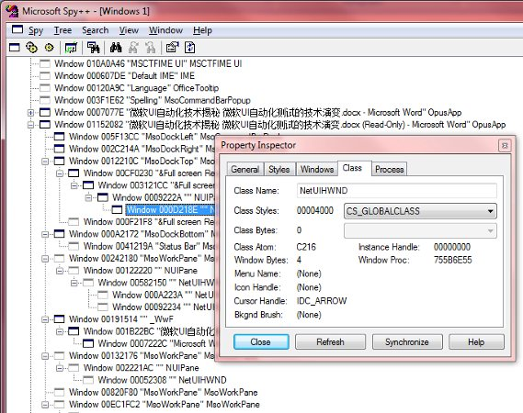
Win32 SDK/Message
Spy++
Classification 11/07/26

Slide 6
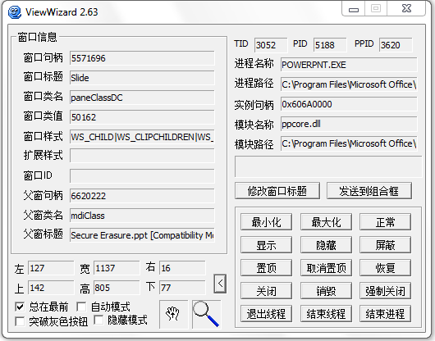
Win32 SDK/Message
ViewWizWard
Classification 11/07/26

Slide 7
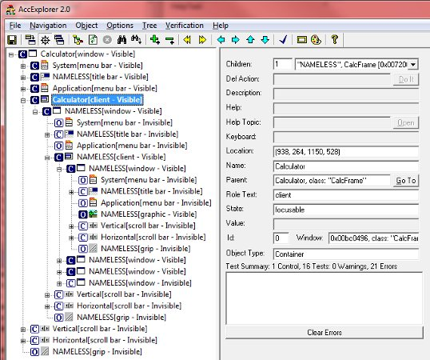
Microsoft Active Accessibility
AccExplorer2
Classification 11/07/26

Slide 8
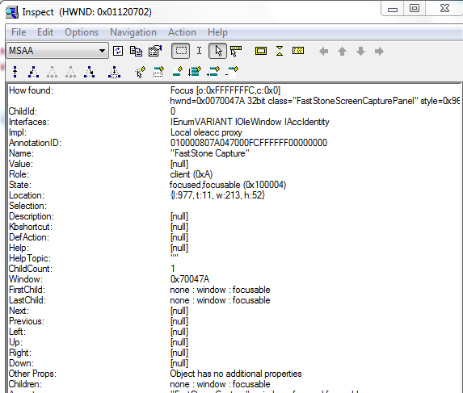
Microsoft Active Accessibility
Inspect
Classification 11/07/26

Slide 9
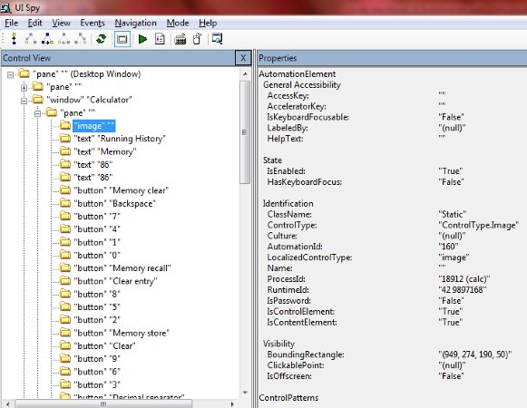
UI Automation
UISpy
Classification 11/07/26

Slide 10
Agenda
Background
MSAA and UIA
pyMSAA Design
pyMSAA Demo
What’ More
Classification 11/07/26

Slide 11
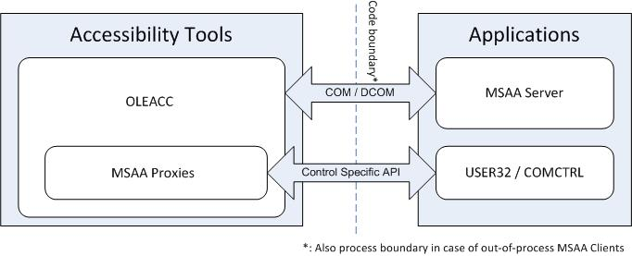
MSAA
Classification 11/07/26

Slide 12
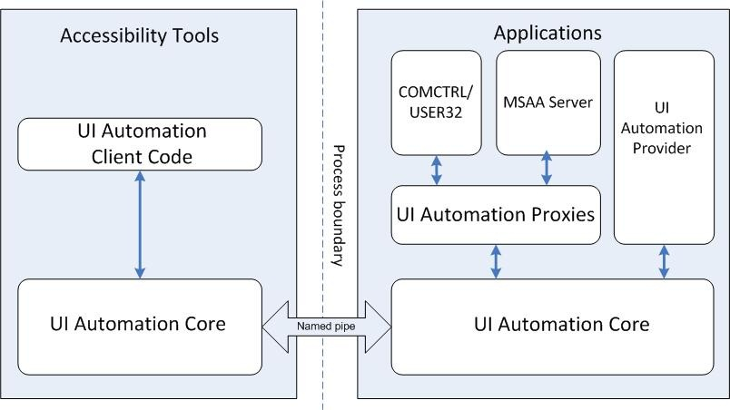
UIA
Classification 11/07/26

Slide 13
Why MSAA not UIA?
UIA is *NOT* stable!
eg) UIA treewalk sometimes break.
http://social.msdn.microsoft.com/Forums/en-AU/windowsaccessibilityandautomation/thread/46e83c55-47b8-4874-9222-7ce2fa58751d
Classification 11/07/26

Slide 14
Next UIA?
Windows Automation API 3.0
  http://msdn.microsoft.com/en-us/library/dd561932(VS.85).aspx
IAccessibleEx
  http://msdn.microsoft.com/en-us/library/dd561898(v=vs.85).aspx
Classification 11/07/26

Slide 15
Agenda
Background
MSAA and UIA
pyMSAA Design
pyMSAA Demo
What’ More
Classification 11/07/26

Slide 16
pyMSAA Design
Based on ctypes/comtypes
pyMSAA class and function
Classification 11/07/26

Slide 17
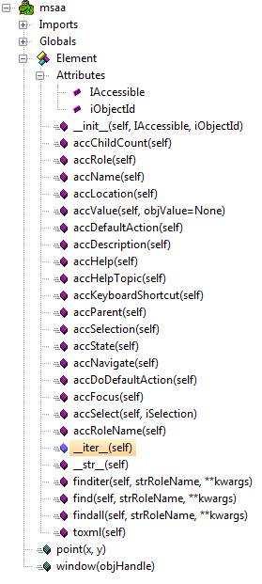
pyMSAA class and function
msaa.Element
msaa.point
msaa.window
Classification 11/07/26

Slide 18
Agenda
Background
MSAA and UIA
pyMSAA Design
pyMSAA Demo
What’ More
Classification 11/07/26

Slide 19
Agenda
Background
MSAA and UIA
pyMSAA Design
pyMSAA Demo
What’ More
Classification 11/07/26

Slide 20
What’s More
IAccessibleEx support
Speed msaa.Element.find(strRoleName, **kwargs)
Refactoring
Classification 11/07/26

Slide 21
THANK YOU!
Classification 11/07/26

